Slide 2
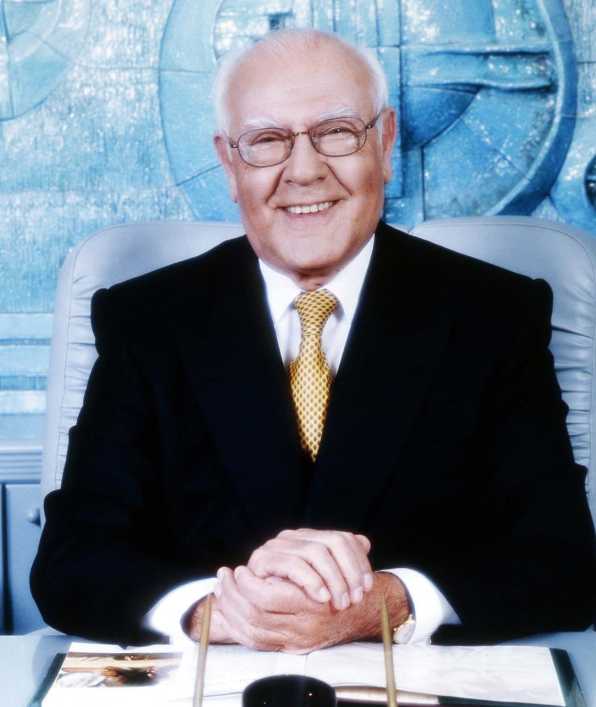
FOUNDER
İnci Holding was founded by Cevdet İnci in 1952
2

Slide 3

ABOUT İNCİ
THE FUTURE IS OURS!
Technology
VISION
International
We grow our corporate value across generations by investing globally in future businesses.
Value
Generation
MISSION
VALUES
Developing our business by Maintaining our core values while increasing benefit to every stakeholder.
We are respectful
We add value
We improve continuosly
We are results driven
3

Slide 4
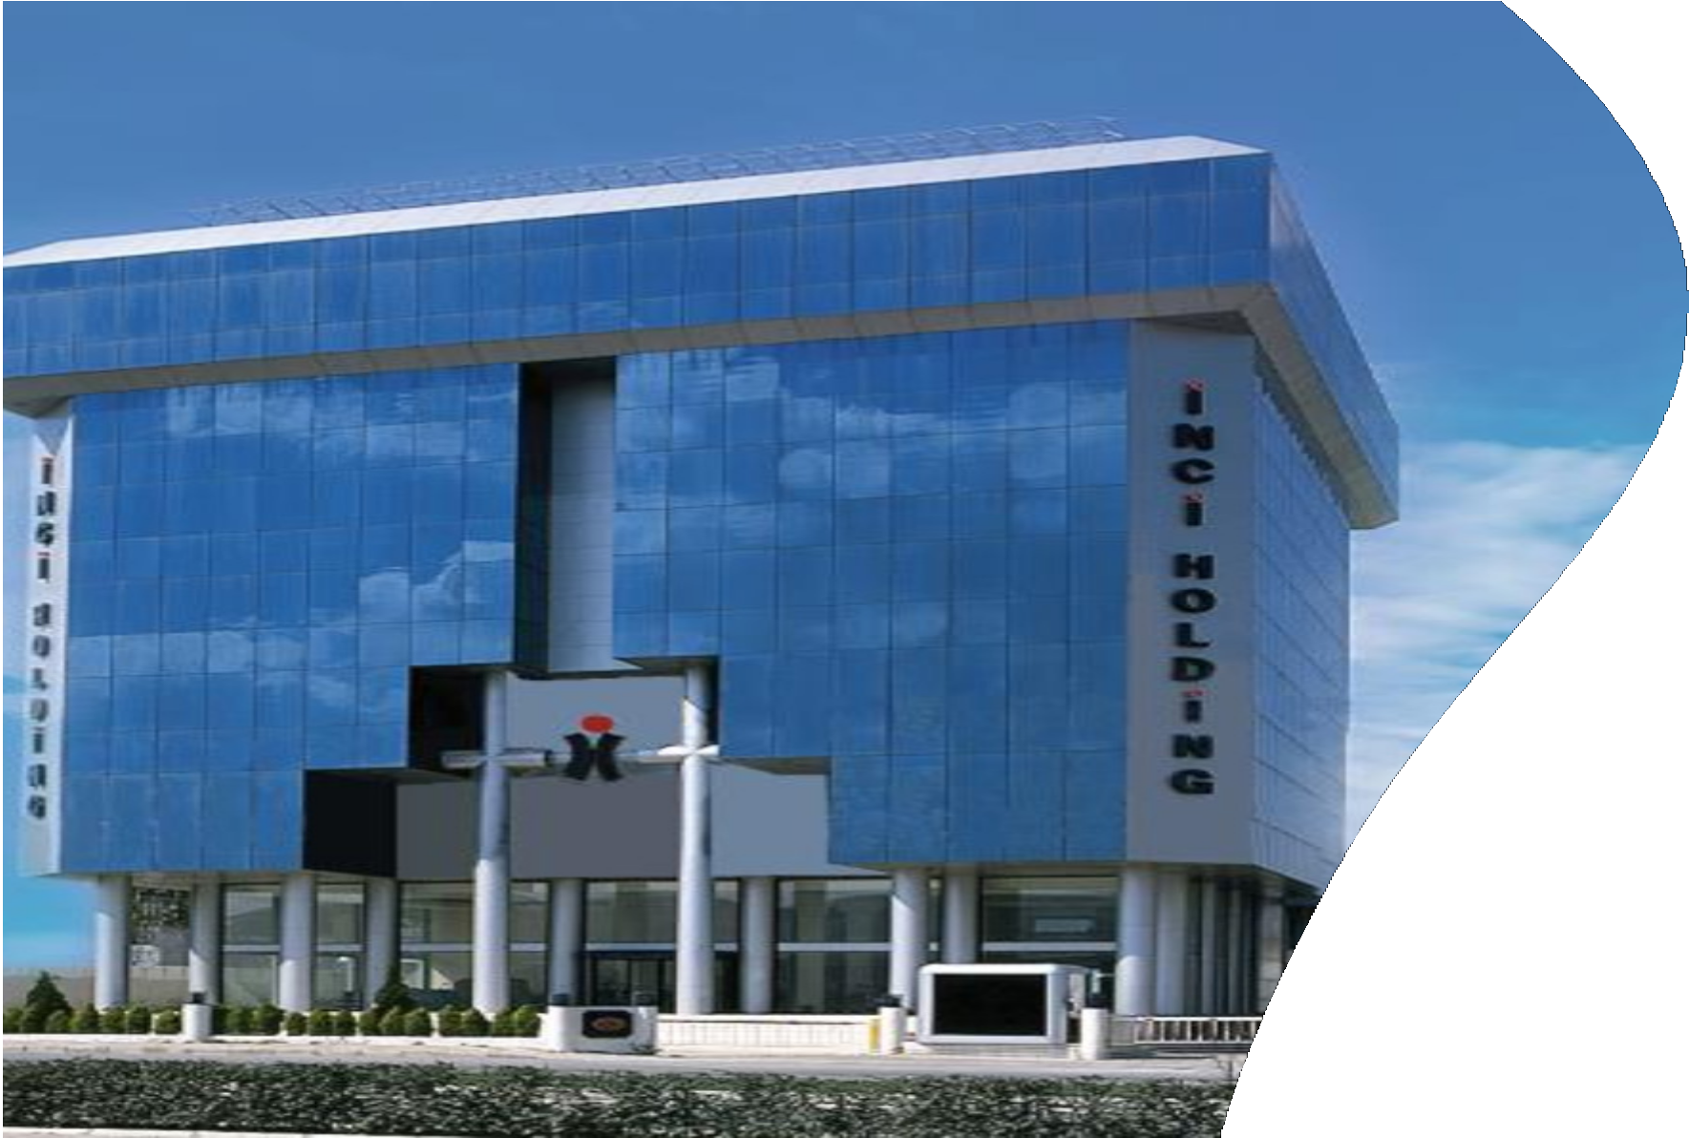
İNCİ HOLDİNG AT A GLANCE
3250
Employees
%60
of production exported to over 100 countries
10
Companies operating in the field of: Automotive, Services, Technology and activities of social responsibility, as an addition.
Theree companies in
Three companies in
1.000
500
TİM’s Top*
İSO’s Top*
3
The board of management
Presidency belongs to
3rd generation
ince 2015
*TİM: Turkish Exporters Assembly
*İSO: Istanbul Chamber of Industry
4
Notes:
10 kuruluş mu? Teyit edilmeye muhtaç bilgi.
Çalışan sayısı Filiz’den teyit edilecek. (3200?)
İhracat oranı Deniz’den teyit edilecek (%60?)

Slide 5



























MILESTONES
1982
İncitaş, Jantaş and İnci Sigorta join to form İnci Holding.
1952
Cevdet İnci establishes İncitaş, his first company.
1985
Cevdet İnci Education was established with the social responsibility awareness in education field.
1968 - 1979
İncitaş develops into one of a few manufactureres of highquality wheels and hubs in the world.
1984
İnci Akü, World’s Battery Expert was established.
1992-93
Jantaş, enters into a partnership with the German Lemmerz Group in 1992. One year later, İnci Akü enters into a partnership with CEAC, biggest company in Europe in its sector.
2012
Partnership was established with Maxion Wheels and renamed as Maxion Jantaş &
Maxion İnci.
2003
The Board of Directors hands over to the second generation.
2000
All the share.s of ISM are acquried
1997
The American Heyes Group purchased the German Lemmerz Group and we renamed our comanies as Hayes Lemmerz Jantaş and Hayes Lemmerz İnci.
1998
İnci Logistics is launched.
2012
İnci Academy established as a corporate academy.
2018
Vinci established as a Venture Capital firm with İnci Holding as its strategic investor.
2022
First Sustainability Report has been published.
2022
AZKarbon, the Digital Marketplace platform, joined our Group.
2014
İnci Logistics and Yusen Logistics enter into a partnership.
2015
İnci Akü and GS Yuasa enter into a partnership.
2016
The Board of Directors hands
over to the third generation.
2020-22
Rhombus, a US technology company, as İnci Holding's first foreign direct investment, was acquired by BorgWarner in 2022.

Slide 6











GLOBAL PARTNERS
1992 - 1997
Lemmerz İnci
(Germany)
1997 - 2011
Hayes Lemmerz İnci
Hayes Lemmerz Jantaş (USA)
2012 - Present
Maxion Jantaş
Maxion İnci (Brasil)
2015 - Present
İnci GS Yuasa
(Japan)
1993 - 1995
İnci Akü - CEAC
(France/Italy)
1995 - 2005
İnci Akü - Exide
(USA)
2014 - Present
İnci Lojistik
Yusen Logistics (Japan)
2020 – 2022
Rhombus
(USA)

Slide 7
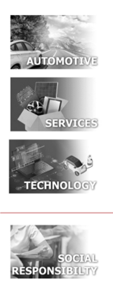















GROUP COMPANIES

Slide 8

AUTOMOTIVE
OTOMOTİV

Slide 9






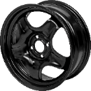



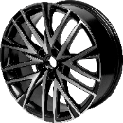

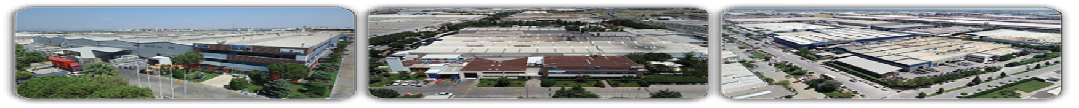

MAXION İNCİ WHEEL GROUP
Commercial Vehicle Steel Wheel Production
338th company in ISO 500 (2021)
264TH company in TIM 500 (2021)
Broad market coverage
- Suppler to all OEMs in Turkey
High quality standards: ISO 9001, IATF 16949, ISO/IEC 27001, ISO 14001, ISO 45001 Ford Q1
 | www.maxionwheelsturkey.com
 | Location Manisa Organized Industrial Zone
 | Established In
 | Maxion Jantaş 1968 | Maxion İnci Steel 1992 | Maxion İnci Aluminium 2006
 | Total Employees
 | 1.800
 | Capacity (Wheel pieces/year)
 | 12,5 Million
 | Land
 | 200.000 sqm |  | 200.000 m²
 | Factory Quantity
 | 5
 | Partnership Maxion Wheels - Brazil
Passenger and Light Commercial Vehicle Steel Wheel Production
Turkey’s passenger and light commercial vehicle steel wheel production leader
153rd company in ISO 500 / 2021
107th company in TIM 1000 /2021
High quality standards
  ISO 9001, IATF 16949, ISO/IEC 27001, ISO 14001, ISO 45001, Ford Q1
Passenger and Light Commercial Vehicle Aluminum Wheel Production
Innovative and competitive aluminum
  Productivity benchmark in Maxion International
153th company in ISO 500 / 2021
107th company in ISO 1000 / 2021
High quality standards
  ISO 9001, IATF 16949, ISO/IEC 27001, ISO 14001, ISO 45001, Ford Q1
Industry 4.0, TPM, Lean Manufacturing, 6 Sigma and others…
Maxion Jantaş Steel Jant
Maxion İnci Steel Wheel
Maxion İnci Alüminyum Wheel
Notes:
Not – ART: Maxion İnci Çelik ve Alüminyum logolar değişti.
Çalışan sayısı revize edildi.
Jant kapasitesi revize edildi.
Kapalı Alan’a yer vermek istemiyoruz.
Arazi yerine Toplam Alan dedik.
TİM güncellendi.
Jant fotoğrafları güncellendi.
Fabrika Sayısı’nı ekledik.

Slide 10
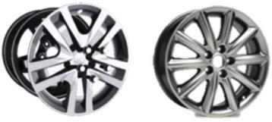
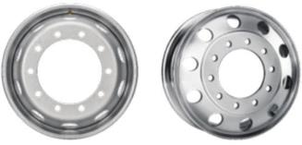
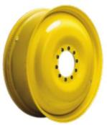



ABOUT OUR PARTNER MAXION WHEELS
LARGEST MANUFACTURER OF ORIGINAL EQUIPMENT PASSENGER CAR, COMMERCIAL VEHICLE AND OFF-ROAD WHEELS IN THE WORLD
PASSENGER CAR + LIGHT COMMERCIAL VEHICLE
Steel and Aluminum Wheels
COMMERCIAL VEHICLE
Steel and Aluminum Wheels
AGRICULTURE/ OFF-ROAD
Steel Wheels
MAXION WHEELS AT A GLANCE
 |  |  | More than 10.000 employees around the world. | Production with 23 factories in 5 continents
Produced more than 50 milion wheels in 2021
Notes:
«100 yıldan fazla» söylemini çıkardık.
5 kıta söylemini çıkardık.

Slide 11













































MAXION İNCİ WHEEL GROUP COSTUMERS

Slide 12

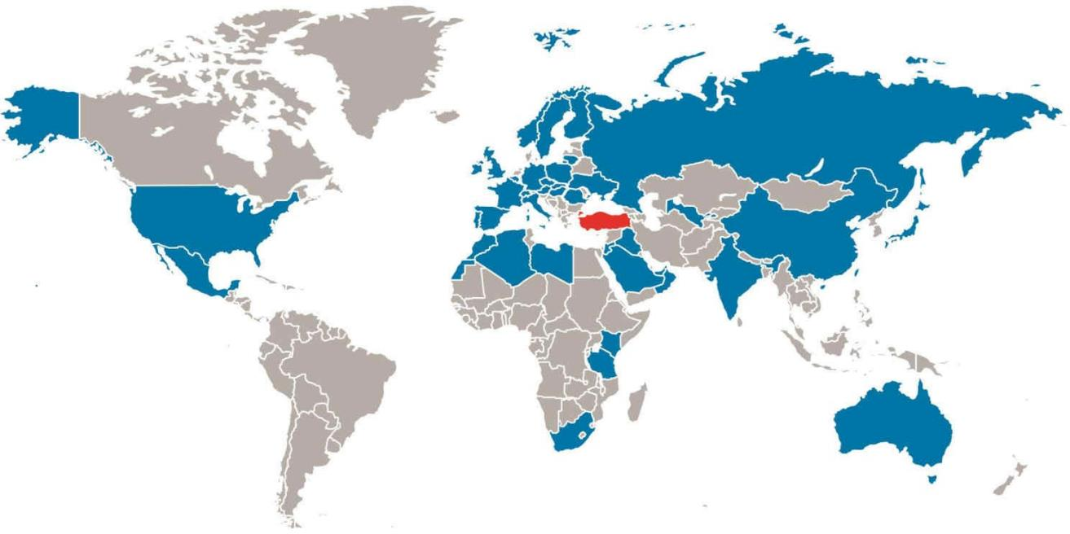
₄₃
MAXION İNCİ WHEEL GROUP EXPORTS
EXPORT TO
EXPORT TO
EXPORT TO
₁₇
₁₆
COUNTRIES
IN THE WORLD
COUNTRIES
IN THE WORLD
COUNTRIES
IN THE WORLD

Slide 13







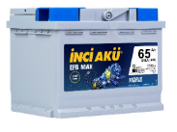

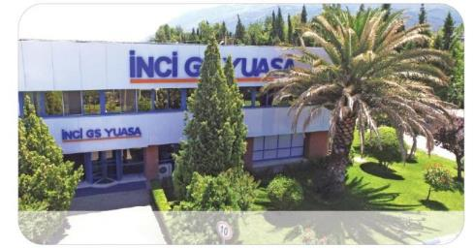
İNCİ GS YUASA
Our Brands
Automotive and Industrial Battery Manufacture
194th company in ISO 500 / 2021
183th company in TIM 1000 / 2021
The first R&D center in the sector in Turkey
First TURQUALITY certificate holder in its sector Turkey’s
First BREEAM (Building Research Establishment Environmental Assessment Method) certified production facility.
High Quality Standards: IATF 16949, ISO 9001, ISO 14001, ISO 45001, ISO 10002
 | www.incigsyuasa.com
 | Location Manisa Organized Industrial Zone
 | Established In 1984
 | Employees 1000
 | Capacity (Batteries/Year) 7 million automotive batteries 700,000 industrial battery cells
 | Land 130.000 sqm
 | Buildings 46.500 sqm (2 Automotive and 1 Industrial Factory)
 | Partnership GS Yuasa – Japan
İnci GS Yuasa Genel Müdürlük

Slide 14
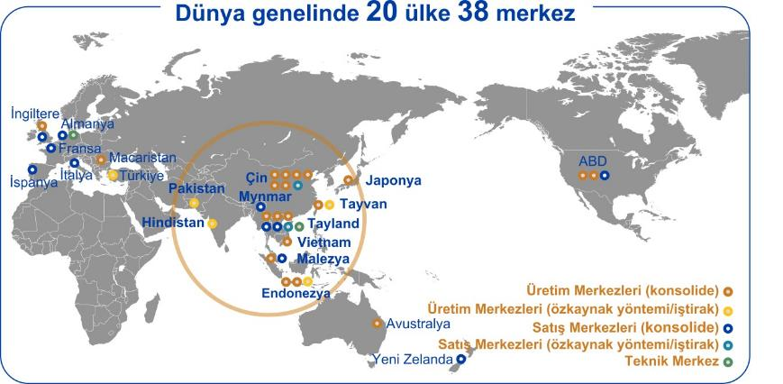
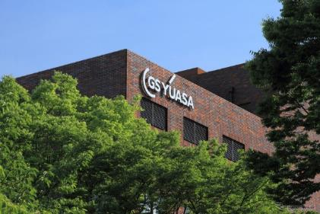





ABOUT OUR PARTNER GS YUASA
20 COUNTRIES AND 38 BASES WORLDWIDE
Worldwide 20 countries 38 bases
GS YUASA AT A GLANCE
ESTABLISHED 2004 Merger between Japan Storage Battery Co. Ltd (est.in.1917) and Yuasa Corporation (est. İn. 1918) | HEAD OFFICE Kyoto, Japan | CAPITAL STOCK 422 Bilion Yen (US$ 3.7 Bilion) | ÇALIŞAN SAYISI 13.305 (2021) | World’s 2nd Largest Battery Manufacturer

Slide 15



































SELECT COSTUMERS
PASSENGER AND LIGHT COMMERCIAL VEHICLES
HEAVY GOODS VEHICLES
INDUSTRIAL

Slide 16
İNCİ GS YUASA IN THE WORLD
₈₀
OVER
COUNTRIES
6
ON
CONTINENTS
İNCİ GS YUASA IN TURKEY
110
PRINICIPAL DEALERS
150
ENERGY EXPERT
260
AUTHORISED SERVICE CENTERS
4.400
RETAIL SALES POINT
15
INDUSTRIAL BATTERY AUTORISED SALES AND SERVICE CENTERS
İhracat Ülkeleri
Genel Merkez

Slide 17

SERVICES
OTOMOTİV

Slide 18




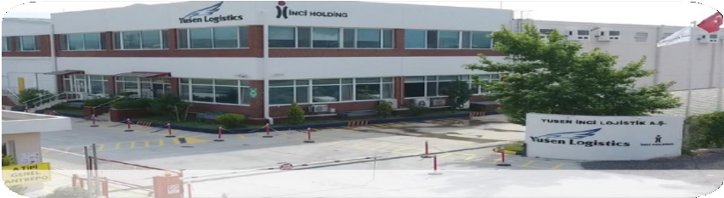


YUSEN İNCİ LOGISTICS
 | www.yusen-logistics.com
 | Location Levent - İstanbul (Head Office) İzmir (Bayraklı Office), Bursa, Manisa, İstanbul (Office) Manisa (Warehouse) İzmir (Warehouse)
 | Established in 1998
 | Employees 195+
 | Total Warehouse 40.000 sqm
 | Indoor Capacity 32.000 sqm
 | Outdoor Capacity 10.000 sqm
 | Partnership Yusen Logistics - Japan
Yusen İnci Logistics Provides Domestic and International Logistics, Supply Chain Solutions and Supply Chain Consultancy Services
Yusen Logistics Turkey and İnci Logistics have merged to form a new company, Yusen İnci Logistic in April 2017.
Services offered:
Air freight forwading
Ocean freight forwading
Warehouse-based services, including (Bonded WH.)
Supply Cargo Management
Project Cargo Management
Yusen İnci Lojistik Kemalpaşa Deposu

Slide 19
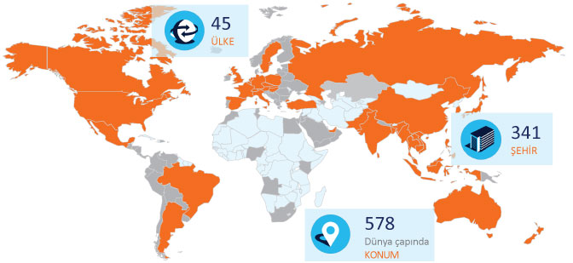

ABOUT OUR PARTNER YUSEN LOGISTICS
GLOBAL NETWORK
A Global Network Spanning Almost
341
cities in
45
countries
YUSEN LOGISTICS AT A GLANCE
Established in
1995
Head Quarter
Japan & Hong Kong
Employees
24.500+
Turnover:
4.2 Billion $

Slide 20



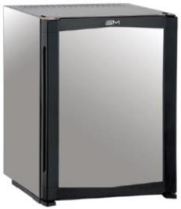
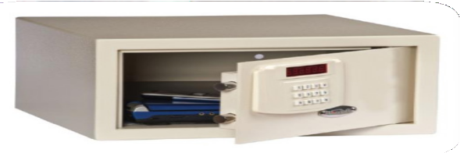
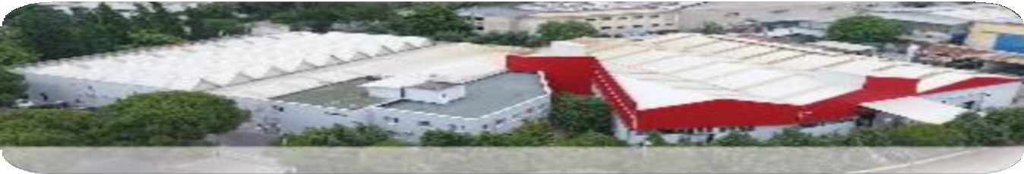
İSM MINIBAR
 | www.ismas.com.tr
 | Location Manisa Organized Industrial Zone
 | Established In 1986
 | Capacity 200.000 pieces/year
 | Land 7.840 sqm
Hotel Equipment Manufacturing
Market leader with 70% marketshare in Turkey
%25 marketshare in Europe
The first company in the world to receive UL certification
Pioneer technology & quality with is approved design center ISMART
Peltier cooler with the lowest energy consumption
Elimination of vibration and noise with absorpiton cooling technology
ISO 9001, ISO 14001, OHSAS 18001, CB, CE, UL, EAC, G-MARK, TÜV GS, RoHS quality certificates.
ISM Minibar Fabrikası - Manisa

Slide 21




















MÜŞTERİLERİMİZ

Slide 22
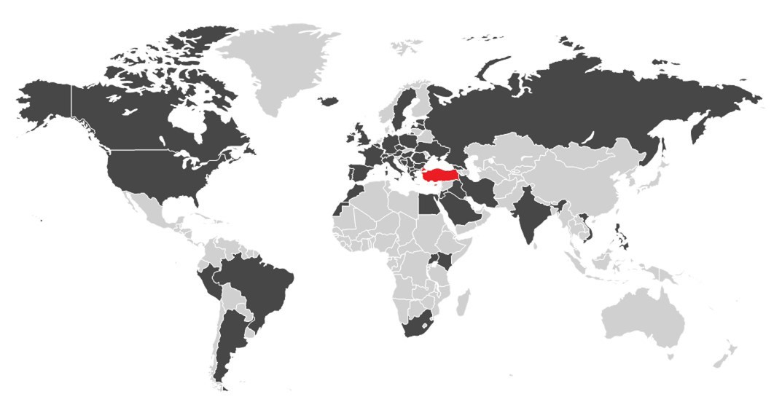
EXPORT OVERVIEW OF ISM
EXPORT TO
57
COUNTRIES
IN THE WORLD
70% of output is exported to over 57 countries on 5 continents.

Slide 23




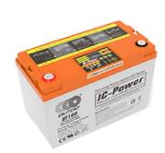

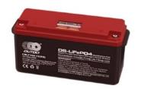


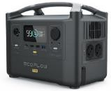
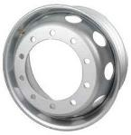





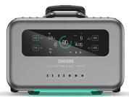
İNCİTAŞ
Our Brands
Sales and Distribution at Automotive and Renewable Energy Sectors
Sales and Distribution Services in the Undustry (B2B ve B2C)
Wide range of a battery for a variety of renewables (automotive, marine and renewable energy)
The largest steel Wheel distrubition company in Turkey
Nationwide and strong distribution for all the distributed brands
In-depth experience in after sales
Fully integrated online systems for sales and marketing activities
Battery
Outdo (Marine and Solar)
Fiamm (Marine and Solar)
Mobile Storage
Ecoflow (Camping, Caravan, Outdoor)
Zendure (Camping, Caravan, Outdoor)
Microinverter:
Tsun (Solar)
Rim
Maxion Jantaş (heavy good vehicles)
Alcar (Passanger, light commercial vehicles)
 | www.incitas.com.tr
 | Locations İstanbul
 | Established In 1952
 | Employees 12
 | Retail Points 188
 | İnci Holding’s First Company

Slide 24

TECHNOLOGY
OTOMOTİV

Slide 25








VİNCİ
Portfoy şirketleri;
 | Octovan: Marketplace for moving bulky goods and homes
 | TIM: Smart gloves providing traceability and productivity improvements in warehousing and assembly line operations in industry.
 | Herotech8: Drone-in-a-box technology for autonomous surveillance, inspection and security operations on industrial and critical infrastructure sites.
 | Mobilus Labs: Hands-free, ear-free, 2-way bone-conduction voie communication platform for field workers.
 | ShipsGO: Container tracking and route search platform
 | Turbit: AI Service company for the wind industry, enables owners and operators of wind farms to make model-driven decisions to increase profitablility and minimize losses due to unplanned downtimes.
 | www.vincivc.com
 | Location Amsterdam
 | Established in 2018
 | Investment Criterias Regions: UK, Germany, Turkey Areas: Mobility, Automotive Technologies, Energy Management & Storage, Supply Chain & Logistics, Industry 4.0 Aşama: Seed & Pre Series A
Sungreen:
Developed nanocoatings to improve the efficiency of hydrogen electrolyser components.

Slide 26




The shopping address of those who think about the future of the world today: AZKARBON.COM
•A shopping site where all products and services from A to Z are intended to reduce carbon emissions;
•A reliable, economical and rewarding experience in the light of sustainability principles, emphasizing the importance of social cohesion for a cleaner and livable world,
•A marketplace that brings together consumers who are aware of the changing global climate and ecosystem, who want to gain information in their shopping experiences, and who want to make renewable and sustainable choices, with suppliers who are experts in their fields and who have an active place in the sector with their products and services,
•Wide product and service portfolio from energy generation to energy efficient devices, from smart devices to mobility
•Sharing up-to-date and important information on the AZKarbon Blog page, which focuses on social benefit beyond commercial purposes, knows the importance of informing as an environmentalist marketplace, and aims to raise awareness of all its stakeholders
•Ability to explore efficient and environmentally friendly products and services as well as to invest in the future while ensuring savings in the resources.
A vertical and focused marketplace for products and services focused on energy, mobility, technology and the environment.
 | www.azkarbon.com
 | Location İzmir
 | Established in 2023
 | Sektörler: A vertical and focused marketplace for products and services focused on energy, mobility, technology and the environment.
26

Slide 27


SOCIAL RESPONSIBILTY
OTOMOTİV

Slide 28






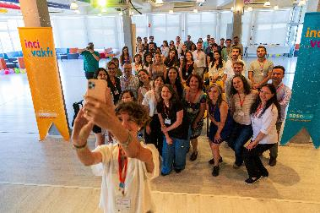

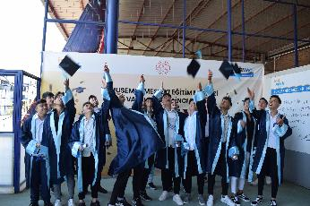

CEVDET İNCİ EDUCATIONAL FOUNDATION
A desire for a society excited by their dreams
 | www.incivakfi.org
 | Location İnci Holding Headquarters
 | Established in 1985
 | Total Scholarship 7,530 Scholars (1985-2022) 27 Training Sessions (2020-2022) 34 Volunteer Trainers (2020-2022)
 | Seminars, Lectures and Workshops for Parents 12.377 people (2015-2022)
 | Mobile Libraries 135.667 children, 59.771 books (2015-2022)
 | Children Orchestra 58 children in between the ages 7-18 (El Sistema Method)
 | Yunusemre Vocational Training Center İnci Foundtation – Maxion İnci Branch 101 Student - 27 Graduate – 19 Employment (2017-2022)
 | Code İnci Project 38 Children (2020-2022) 25 Volunteer Trainers (2020-2022
Support by education, incentives and networking programs for improving social eco-system with the motto of «Support to Education, Service to Future»
Experiences insprinig to the making dreams target, and targets excitement in order to make contributions to the development of the generations who are at peace, free, initiative and impressive
Promoting approaches by «Cevdet İnci Incentive Awards» supporting in-house entrepreneurship
The desire to bring education to the each and every section of the society, which is the dept of gratitude by establishing coopreration with NGOs and volunteers.
Participation in Marathons with volunteer runners for fundraising efforts.
With the «Hasat Grant Program», we support postgraduate students' projects related to sustainability with a focus on Air, Water and Soil.
Notes:
GÜNCEL SUNUM BEKLENİYOR.

Slide 29



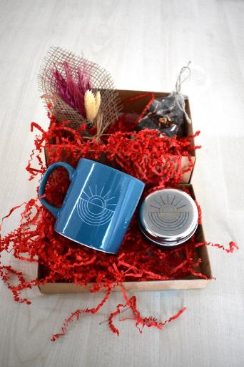

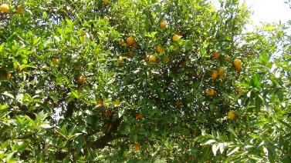
CEVDET İNCİ EDUCATIONAL FOUNDATION
COMMERCIAL ENTERPRICE
Economic Enterprise of Cevdet İnci Education Foundation
At the end of the year, all revenues will be transferred to the Foundation for the use of Cevdet İnci Education Foundtation in its educational activities,
Organizing trainings for the needs of institiutions with İnci Academy,
Production and sales of fruits, vegetables and agricultural products obtained from the lands of the İnci Foundtation with Good Agricultural Practices.
 | www.incivakfi.org
 | Location İnci Holding Headquarters- İzmir
 | Established in 2006
 | Different Subjects İnci Academy 11.475 participants in 151 different subject Online Store VİVO Olive Oil Dip Roman Pomegranate, Greengage, Orange, Mandarin, Avocado Special Day Gifts
Notes:
Burası olmalı mı olmamalı mı? [Neden koyulduğu Nesrin’den teyit edilecek.]

Slide 30

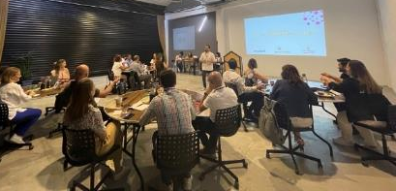
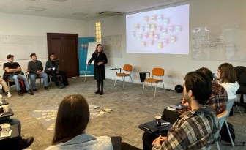


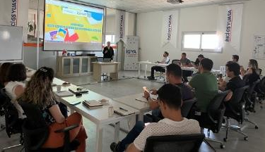
İNCİ ACADEMY
An important solution partner of the business world in development and change
Special training program designs on digital transformation, leadership and competence development, institutionalization in family companies, corporate social responsibility, organizational development for the needs of institutions;
Contribute to the development of İnci Holding, group companies, the business world and all relevant professionals,
Be a development partner that will benefit individuals and the business world with the philosophy of lifelong learning,
Transfer all non-profit income to İnci Foundation's scholarship fund
 | www.inciakademi.com
 | Location İnci Holding Headquarters- İzmir
 | Established in 2012
 | Total Number 11.475 participants
 | Different Subjects 151
 | Satisfaction Surveys % 96

Slide 31
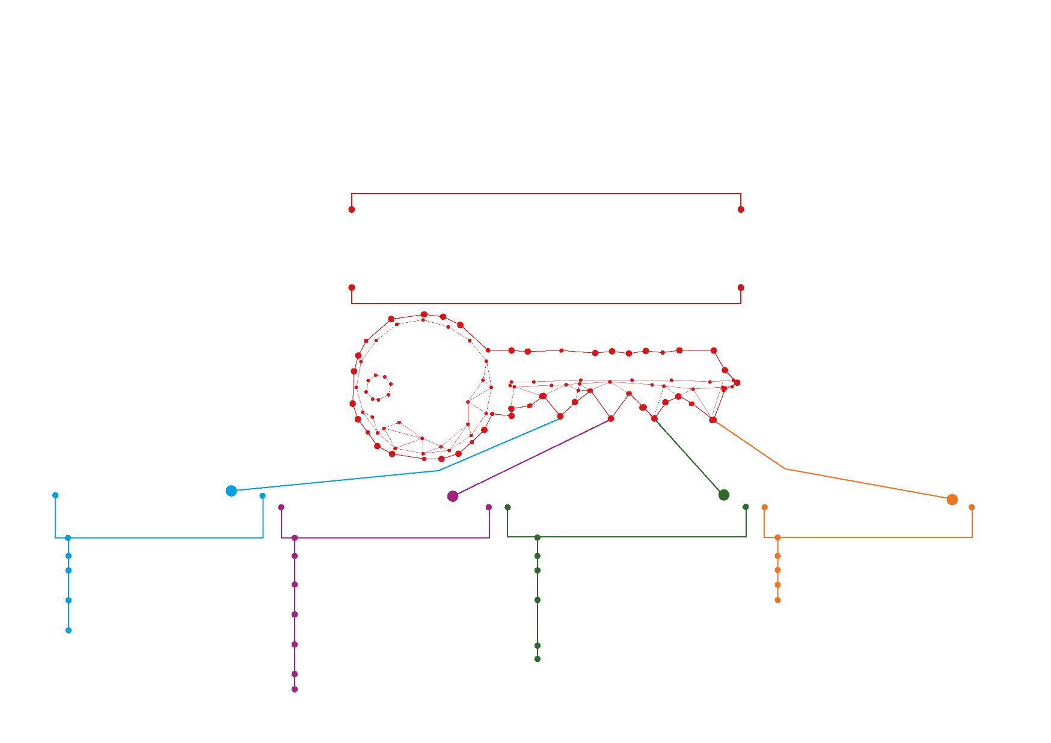
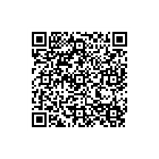
SUSTAINABILITY REPORT
We transfer the value of the company to new generations by multiplying it with international investments in future business areas
Investment in Institutionalization for
New Generations
Investment in Responsible Production / Responsible Consumption for New Generations
Investment in People and Society for New Generations
Investment in Innovation for New Generations
1.1. Corporate Management
1.2. Ethics Management at
İnci Holding
1.3. Risk Management and Internal
Audit at İnci Holding
1.4. Working with Global Partners
2.1. Support for Quality Education with İnci Foundation
2.2. Support for the Development of Institutions
2.3. Contribution to Employment – Decent Work
2.4. Gender Equality / Empowerment of Working Women
2.5. Employee Health and Safety
2.6. Talent and Loyalty Management
3.1. Efficient Use of Resources
(Energy, Water, etc.)
3.2. Development of Environmentally Friendly Products and Services
3.3. Waste Management and Circular Economy
3.4. Sustainability in the Supply Chain
3.5. Leading Role in Complying With and Shaping the Sustainability Expectations of the Market
4.1. Collaborations with the Ecosystem
4.2. Investment in Future Business Areas
4.3. Corporate Entrepreneurship
4.4. Digital Transformation
To access the report
You can scan the QR code!

Slide 32





























MEMBERSHIPS
Notes:
Üyeliklerimiz Burcu’dan teyit edilecek

Slide 33
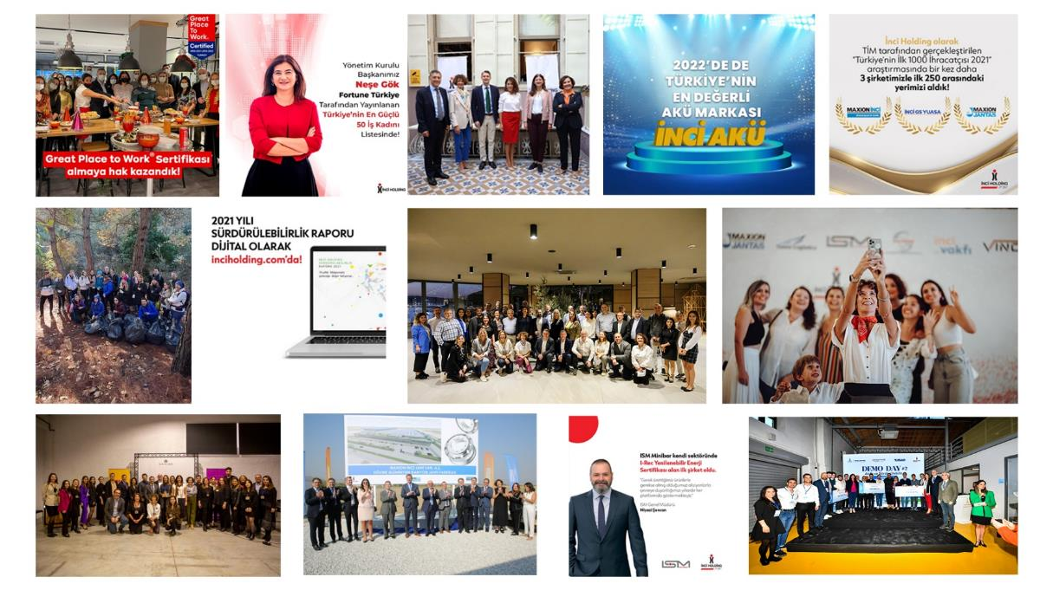

THANK YOU
www.inciholding.com
www.facebook.com/inciholding
www.twitter.com/inciholding
www.instagram.com/inciholding
www.linkedin.com/company/inci-holding
www.youtube.com/inciholding
blog.inciholding.com/

